Slide 1
Lead Poisoning: A Pediatrician’s Perspective (1969-2016) It’s Still the Lead Paint
Howard L. Weinberger, MD
Professor Emeritus of Pediatrics
Upstate Medical University
November 8, 2016

Slide 2
Disclaimers and “Confessions”
I have no connection (formal or otherwise) with the paint industry
I have served as the Medical Consultant to the Onondaga County Health Department since 1969
I am the Medical Director of the Central/ Eastern New York Regional Lead Poisoning Resource Center (1986-present) which is funded by the NY State DOH

Slide 3
Objectives:
To provide a brief history of lead poisoning in the US as a Public Health Success Story
To recognize three “Heroes” in this Story
To explain how much we have learned about the effects of lead in children, while “basking” in our success
To explain why lead poisoning is still a problem for children and will be a concern well into the future

Slide 4
Brief Review of Lead Poisoning
Lead is a valuable element
It is ubiquitous in nature
It is useful in industry
At least as early as the Roman Empire (PLUMBING) It was also used as a preservative and a sweetener for making wine
In the paint industry, it is used to make white paint whiter and to enhance the brightness of color paints
Today it is found in the computer industry
And, it never degrades

Slide 5
The Bad News
Lead is toxic
Benjamin Franklin letter to a friend (1786)
Brisbane Australia (1892)
First description in the US (1914) (seizures and death)
Lead toxicity causing long term deficits (1943)
No clinical signs – yet subtle deficits (1970’s)

Slide 6
Case History: N.L. – born 1965
6 year old with global developmental delay; UA with glycosuria and proteinuria
Flat plate of his abdomen showed radio-opaque “flakes” and venous blood level 236 ug/dL
Chelation with BAL and Ca EDTA
Day 2 of treatment, BLL:102 ug/dL; hypertensive & comatose. Treated with mannitol and steroids (for presumed lead encephalopathy). Second course of chelation.
Day27 of treatment, he died.

Slide 7
What can we learn from this case?
In 1971, there were few services for children like N.L.
No Early Intervention
Head Start had just begun in the late 60’s
There was no universal Pre- K
His parents described pica behavior, but were unaware of the potential hazard of lead paint in their home

Slide 8
What can we learn from this case?
And, I hoped I would never have to treat another child with lead poisoning

Slide 9
Main Sources of Lead Exposure in Children
Leaded gasoline
Lead Paint

Slide 10
Creating the lead burden in the US
In the 1920’s, lead was added to gasoline to reduce “knocking” in the internal combustion engine in the auto industry (thanks to the efforts of General Motors)
And,
Despite the efforts of Dr. Alice Hamilton
(the first Hero of our Public Health
Success Story)

Slide 11
First Hero Alice Hamilton, MD (1869-1970)

Slide 12
Alice Hamilton, MD
MD from the U of Michigan
First woman on the faculty at Harvard – Dept of Industrial Medicine
1911- published a study demonstrating the prevalence of lead poisoning in industry
Early 1920’s – warned against adding tetra-ethyl lead to gasoline
1995 – U.S. postage stamp in her honor
Brush With Death: A Social History of Lead Poisoning, Christopher Warren
Johns Hopkins Press, 2000

Slide 13
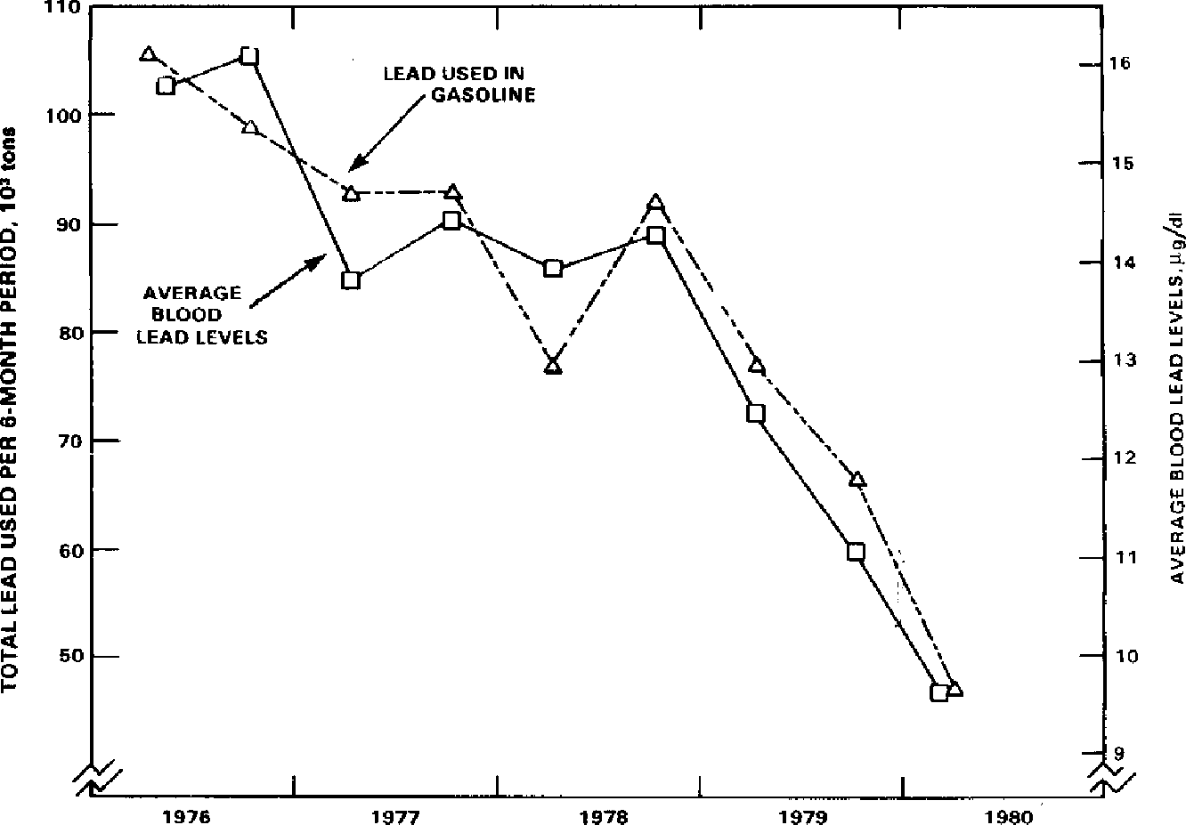

Slide 14
Main Sources of Lead Exposure in Children
Leaded gasoline
Lead paint
1978- federal legislation limiting the amount of lead in indoor paint

Slide 15
Dennis Nett: Syracuse.com 9/15/2016

Slide 16
“Snap shot”of pre-1979 Housing in Central New York
United States 58.2%
NY State 79.2
Broome 80.4
Cayuga 72.7
Chenango 70.2
Cortland 79.7
Herkimer 75.3
Jefferson 62.5
Lewis 64.9
Madison 69.9
Oneida 79.2
Onondaga 74.8
Oswego 64.7
St. Lawrence 71.1
Tompkins 65.0

Slide 17
Blood Lead Testing
1991 Mandate by NYState DOH
Blood lead testing on all children at one and two years of age – with risk assessment until age 6
Currently, only 11 states and Washington, DC mandate some testing
http://www.reuters.com/investigates/special­report/lead­poisoning­testing­gaps

Slide 18
Effectiveness of the Mandate
% of children with two blood lead tests by three years of age
NY State 56.3%
Onondaga County 41%*
In the early 1990’s ~1 million preschool children had BLL’s >10 mcg/dL
In 2016,~500,000 preschool children have blood leads >5mcg/dL**
* NY State Community Health Indicator Report (2012-2014)
**Prevention of Lead Toxicity Council of Environmental Health, American Academy of Pediatrics Pediatrics; 138:1, July 2016

Slide 19
Biologic Effects
of Lead
on Adults &
Children

Slide 20
Major Organ Systems Affected
Effect on Heme synthesis
Effect on the brain and nervous system

Slide 21
Effect on
Heme Synthesis

Slide 22
Examples of Lead Toxicity in the Nervous System
Distortion of enzymes and proteins
Lead competes with calcium for binding sites, affecting neural signaling
Diverse effects on the CNS
Interferes with myelin formation
In high doses, causes brain edema
Needleman, H. Lead Poisoning Annu.Rev.Med. 2004;55:209-22

Slide 23
Lead poisoning in the 1950’s
In the 1950’s, Baltimore was arguably the epicenter of childhood lead poisoning
Some questioned why other communities were missing cases of lead poisoning
An “epidemic” of lead poisoning in Chicago was recognized by Dr. Robert Mellins ( a USPHS officer assigned to study an outbreak of Poliomyelitis)
Ref: Lead Wars – Markowitz,G and Rosner,D U. of Calif. Press, Berkeley, CA, 2013

Slide 24
Second Hero Dr. Herbert Needleman

Slide 25
Dr. Herbert Needleman
MD from U. of Pennsylvania
Residency in Pediatrics and Child Psychiatry
Encountered children hospitalized with very high BLL’s associated with exposure to lead paint in their homes
Professor of Pediatrics and Child Psychiatry – U of Pittsburgh Medical School
Published research on relationship of dentin lead and behavior in school aged children (NEngJMed 1979)

Slide 26
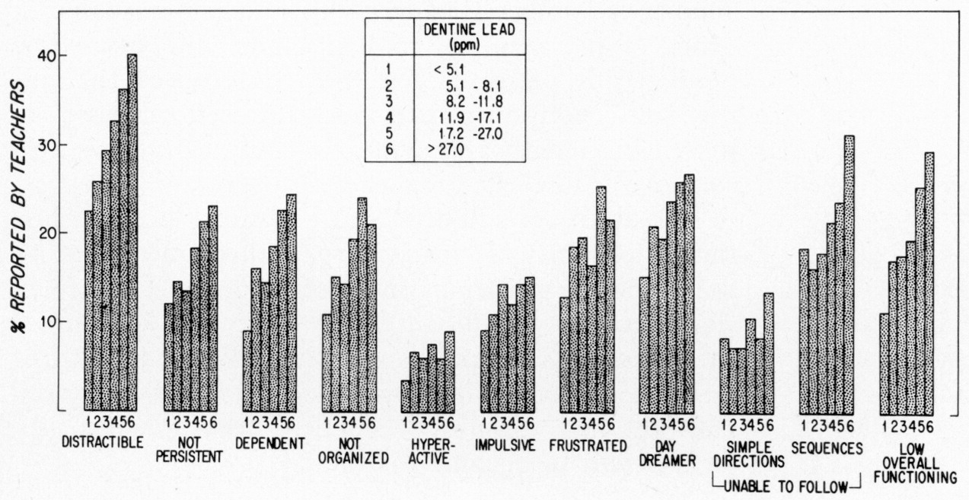
Needleman HL et al. N Engl J Med 1979;300:689-695
Distribution of Negative Ratings by Teachers on 11 Classroom Behaviors in Relation to Dentine Lead Concentration.
Notes:
Figure 2. Distribution of Negative Ratings by Teachers on 11 Classroom Behaviors in Relation to Dentine Lead Concentration. The group boundaries were chosen to obtain symmetrical cell sizes for the median (Groups 1 and 6 = 6.8 per cent, Groups 2 and 5 = 17.6 per cent, and Groups 3 and 4 = 25.6 per cent).

Slide 27
Other Correlations with Elevated Blood Lead Levels
Effect of blood lead levels on IQ
-for every 10 mcg/dL rise in BLL, there is a decrement of 6 IQ points*
- estimate of 23 million IQ points lost in a 6 year cohort of children**
Correlations have been reported about violent behavior in young adults and childhood exposure to lead***
*Policy Statement – Prevention of Childhood Lead Toxicity . Pediatrics V138:1, July 2016
**Bellinger,DC A Strategy for comparing contributions of environmental chemicals and other risk factors to neuraldevelopment of children. Environ Health Perspect 2012:20(4):501-507.
***Stretsky,PB and Lunch, MJ The relationship between Lead Exposure and Homicide. Arch Ped Adol Med 2001;155:579-82
Reyes,JW Environmental Policy as Social Policy? The impact of childhood lead exposure on crime. BE J Econ Anal Policy 2007;7(1) 1-41

Slide 28
Evidence of Success
CDC’s Action Level for Blood Lead
in Children has Steadily Declined
1960-1970 60 mcg/dL
1970-1985 30 mcg/dL
1985- 1991 25 mcg/dL
1991- 2011 10 mcg/dL
2012-present <5 mcg/dL*
* CDC “Reference Value”

Slide 29
The Prevention Paradox: Loss of IQ in US
Children @ Different Levels of Blood Lead
AAP Policy Statement
Pediatrics 7/2016

Slide 30
Main Sources of Lead Exposure in Children
Leaded gasoline
Lead paint
What about the water?

Slide 31
What about the water?
The Third Hero
Dr. Mona Hanna- Attisha

Slide 32
Dr. Mona Hanna- Attisha
MD from Michigan State University (Flint)
Resident in Pediatrics – Children’s Hospital Detroit
MPH from U of Michigan School of Public Health
Currently, Director of Ped. Residency at Hurley Medical Center (Flint, Michigan)
Director of “Pediatric Public Health Initiative”

Slide 33
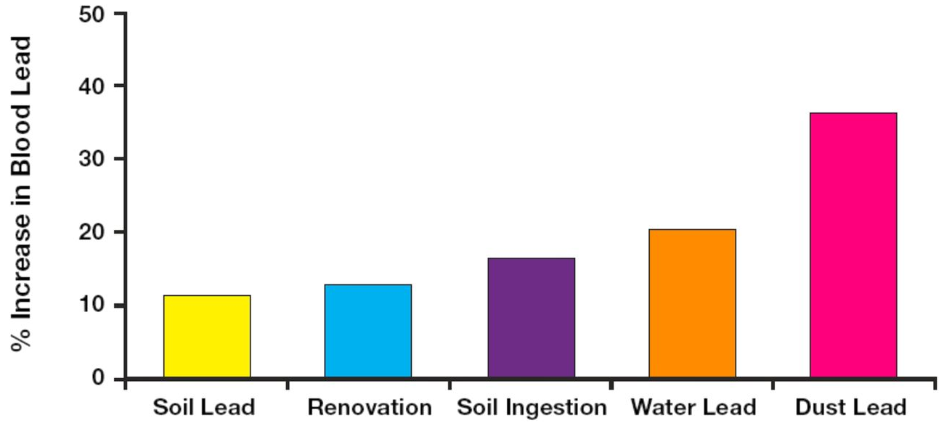
Contribution of Lead Exposure to Children’s Blood Lead Concentration (from Lanphear et al)
AAP Policy Statement Pediatrics 7/2016

Slide 34
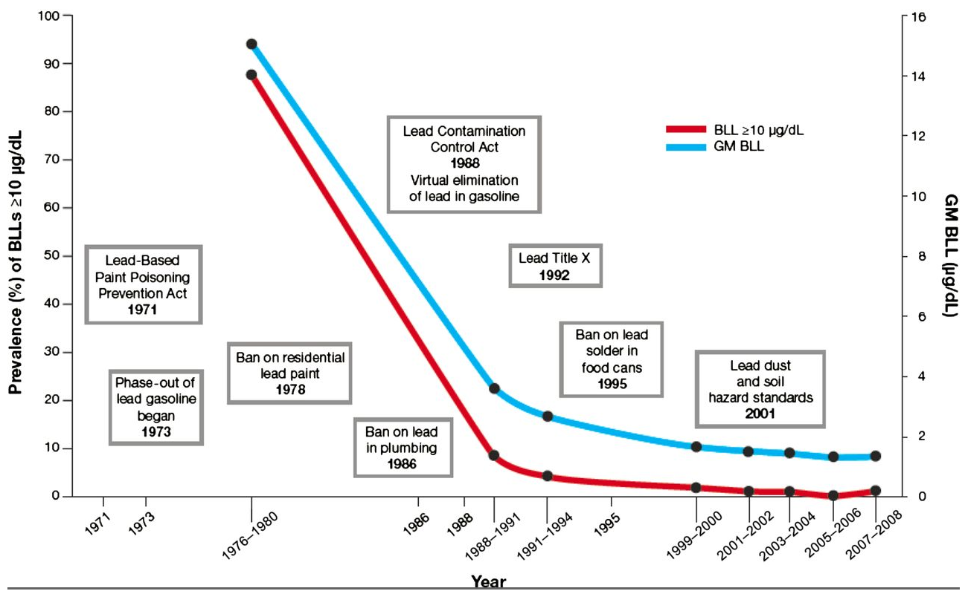
AAP Policy Statement Pediatrics 7/2016

Slide 35
Case history: BF born 2013
3 ½ year old from Watertown with Autism
Blood lead level of 5ug/dL at one year of age (not tested at 2 years)
Noted to have pica behavior and mother said he was constipated
Blood lead tested by Developmentalist in Rochester -64 ug/dL
Admitted for chelation to Golisano Children’s Hospital (September 2016)

Slide 36
What can we learn from this case?
In contrast to our first case (1971)
Many services were available to this child with a diagnosis of Autism
Early Intervention
Early Head Start
Developmental pediatrician
Parents noted his pica behavior and a blood lead test was ordered

Slide 37
The sad part is that he did not have a blood lead test at 2 years of age, as mandated, which might have identified his lead exposure earlier and avoided the need for chelation

Slide 38
Another Measure of Success Lead Chelations at Upstate
Mobilization tests * Chelations
1982 36 31
1985 26 28
1989 20 18
1993 19 21
1998 13**
2010 20
2015 18
2016 15 (to date)
*Weinberger,HL, Post, EM et al An Analysis of 248 Initial Mobilization Tests Performed on an Ambulatory Basis. AmJDisChild, 1987; 141: 1266-1270
** Chelations done in the Central/Eastern Region of NY State

Slide 39
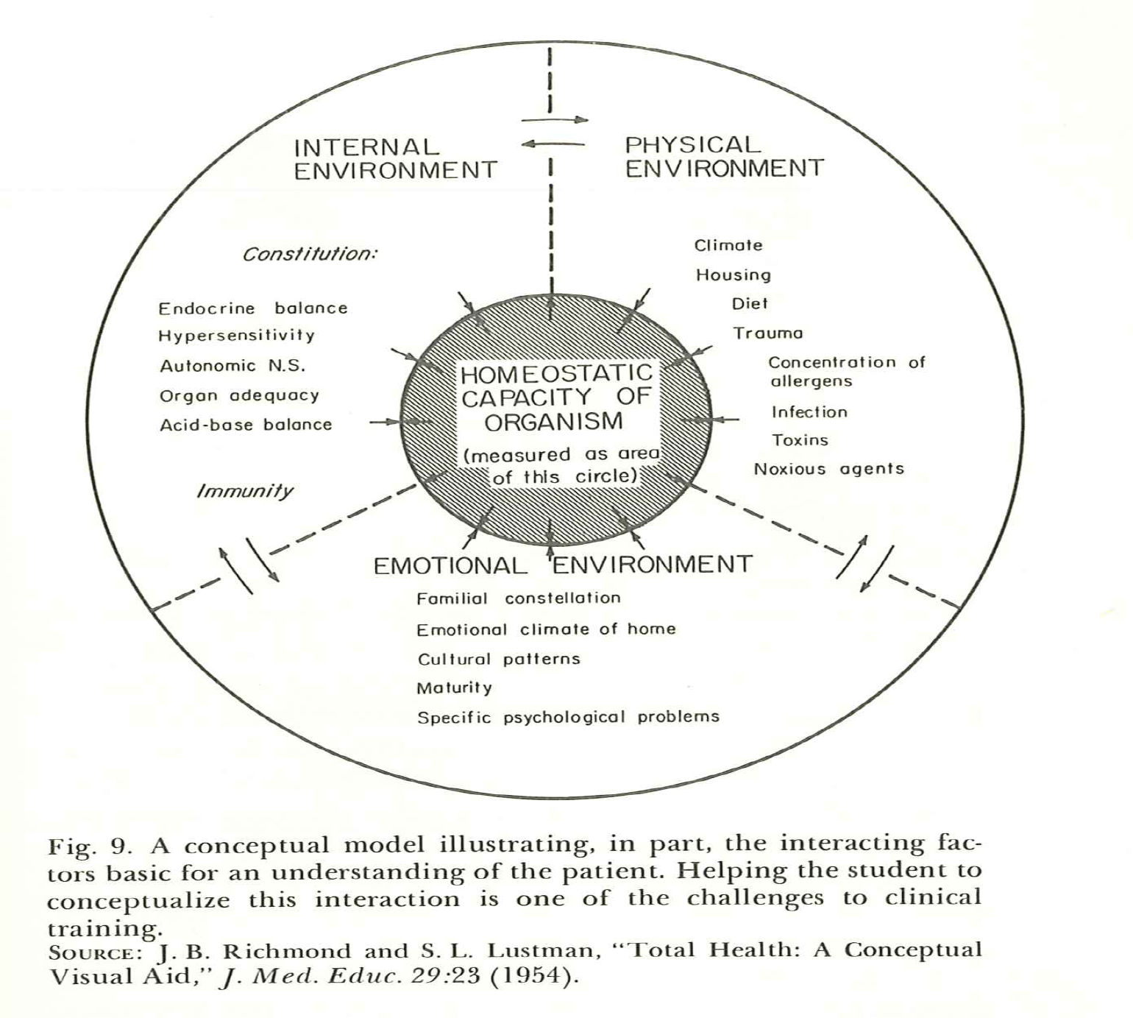

Slide 41
Lessons I Have Learned
Although lead is an “equal opportunity” toxin, the great majority of clinical cases occur in children living in poverty
There are many sources of exposure to lead in our environment, but Old Leaded Paint is still the main source of exposure for children in the U.S.
There is no safe blood lead level
Lead Poisoning is preventable
Primary prevention makes sense

Slide 42
Primary Prevention Actions
Removal of lead from gasoline (1970’s)
Limiting lead in household paint (1978)
“Selective” home renovations (windows and door frames – Rhode Island)
Blood lead testing at one and two years of age (limited to 11states)
Real estate disclosures of lead hazards prior to rental/sale
Pro-active home assessment of lead risk (Rochester, NY) “Test homes, not Kids”

Slide 43
Areas of Concern and Challenges
Cooperation of medical providers (incl OB’s) -prenatal exposure to lead
Lead exposure in New Americans (before and/or after resettlement)
Cost of home renovations to make them “lead safe”
Cost of new lead-free housing
“Lead Fatigue”

Slide 44
Acknowledgements “Collaborators” over the years
Medical students, countless residents and nurses (who helped care for our patients over the years) and faculty colleagues
Special mention:
S.Blatt, J.Boyd, D.Clark, C. Crosley, J. Friedman, B. Helu, J. Henderson, A.Levy, B. McCarthy, H. Mintz, R. Nelken, E. Post, M.Weitzman, T. Schneider
Colleagues from OCHD:
M. Burdick, S. Klineberg, D. Lewis
And, extra-special mention- M.Butler and T. Hobart

Slide 45
CENTRAL / EASTERN NEW YORK LEAD POISONING RESOURCE CENTER Medical Director – Howard L. Weinberger, MD Assoc. Director – Travis Hobart, MD Program Coordinator- Maureen Butler, RN

